Slide 1
Customer Segmentation By Book Purchase History
Group Newbee:
Macy Bao, Chuyu Chen, Zheyu Han
Xijie Liu, Minbo Sun, James Yang

Slide 2
Group Introduction
Customer Satisfaction Manager
Xijie
Strategist; Commander
SEM/SEO Analyst
Chuyu
Analyst; Deliverer; Problem solver
Ecommerce Financial Manager Linghao
Catalyst; Self believer; Strategist
Data Analyst
Minbo
Analyst; Problem solver; Deliverer
Data Scientist
Zheyu
Analyst; Philomath; Problem Solver
Customer Retention Manager
Macy
Analyst,Empathizer,Philomath
Notes:
High 5 Strength
Xijie: Problem Solver; Focus; Strategist; Commander; Philomath; Customer Satisfaction Manager
Chuyu - 1.analyst 2.deliverer 3. Problem solver 4. Philomath 5. Time keeper Performance marketing SEM/SEO analyst
Linghao: Catalyst; Self believer; Strategist; Philomath; Peacekeeper; Ecommerce Financial Manager
Zheyu: Analyst; Philomath; Problem Solver; Commandar; Optimist Data scientist
Minbo: 1.Analyst; 2. Self Believer;3.Catalyst; 4.Problem solver 5. Deliverer; Data Visualization Specialist,
Macy: Analyst; Empathizer; Philomath; Problem solver; Chameleon; Customer Retention Manager

Slide 3
Agenda
1
2
3
4
5
6
Data Analysis
Insights
Problem background
SMART & SWOT Analysis
Competitor Analysis
Model Evaluation
Notes:
High 5
Chuyu - 1.analyst 2.deliverer 3. Problem solver 4. Philomath 5. Time keeper
Zheyu: Analyst; Philomath; Problem Solver; Commandar; Optmist; Data scientist
Macy:Analyst,Empathizer,Philomath,Problem solver,Chameleon
Linghao：Catalyst,Self believer ,strategist ,philomath,peace keeper

Slide 4
Problem Background

Slide 5
Problem Background
Background: the previous approach from our client is the "most popular” items recommendation system, based on customers’ purchase history and the purchased items’ relationship with the ecommerce website, that directs users to add items to their shopping carts. This method has successfully increased sales for this website in the past, but we have a better “Recommendation Engine” system that can apply on a broader customer pool (by clustering customers and apply different further approaches to different segments).
Data: Online Book Ecommerce Data.
Approach: Our “Recommendation Engine” AI solution for this ecommerce website is to implement the unsupervised clustering(K-Means) method, which creates customer segmentations (by giving different RFM scores, also based on their prior purchases and relationship with the ecommerce website), and evaluated the results (for further actions catering to different customer segments).
Notes:
complete with economic analysis and presentation to management to convince the CMO to implement the solution.
Description: An ecommerce website currently recommends “most popular” items to all users with the hope that users will add items to their shopping cart and increase the size of each purchase. This approach is successful by increasing sales for the website and the current CMO/Webmaster do not believe there is a more intelligent solution that is more relevant to each users

Slide 6
SMART & SWOT Analysis

Slide 7
SMART Framework
Specific:
Increase total revenue by 8% of the book selling website within the US.
Measurable:
Increase total units sale by 10%. In additional, increase sales by 12% for most engaged customers and 3%-5% for the rest of customers.
Actionable:
Develop an AI Recommendation Engine to create customer segmentation, send out promotions or product suggestions by email / text messages / notifications to establish great relationship with customers. Increase marketing spending to incentivize customers with low engagement or to encourage new customers to make purchase.
Relevant:
Significant improvements in the recommendation engine system would drive better accuracy to customer in different segments based on their prior purchases.
Time-bound:
Build, test, and implement the Recommendation Engine in 30 days; Drive to increase sales volume by 10% from the most engaged customer and 3% - 5% from the rest in 90 days.

Slide 8
SWOT Analysis
Strength
Affordable prices, discounts
Products cover wide range of book categories
Brand recognition among existing customers
Weakness
Resources spent on inventory management might erode profits
Do not currently have a recommendation system, leads to a higher rate of missed opportunity
Requires more investments in new technologies
Opportunity
Create physical retail stores as a community experience
Create global market, attract more users from overseas
Implementing data analysis to better fit customer needs
Threat
Increase amount of eBook platforms and electronic version of books
Uncertainties in the supply of new products, lead to high and low swings of sales
Price differences with competitors

Slide 9
Competitor Analysis

Slide 10
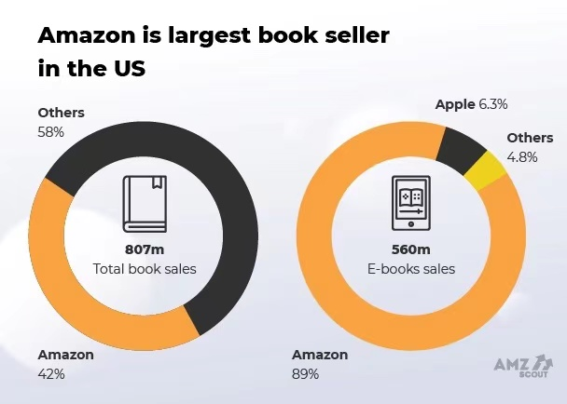
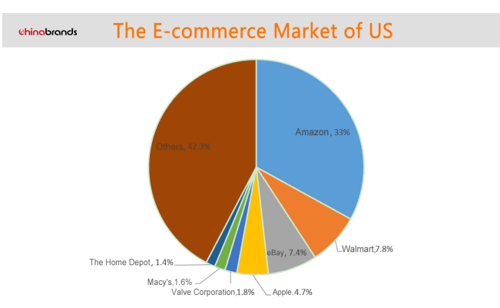
Competitor Analysis

Slide 11
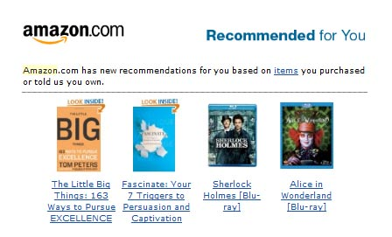
Competitor Analysis
On-site personalized recommendations
Item-to-Item Collaborative Filtering
Improve personalized shopping experience
Increase average order value and the amount of revenue generated from each customer
Produces recommendations in real time, scales to massive data sets, and generates high quality personalized recommendations.
McKinsey estimated that 35 percent of consumer purchases on Amazon come from product recommendations

Slide 12
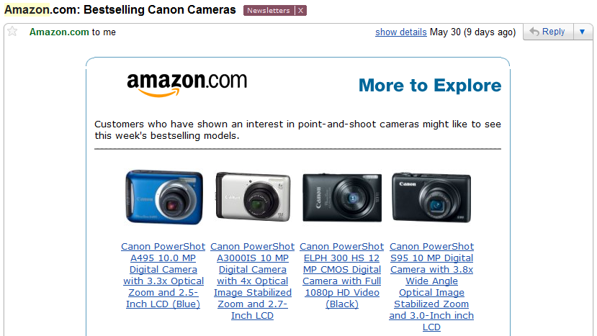
Competitor Analysis
Off-site personalized recommendations with Emails
Divide customers into different segments: homepage browsers, category browsers, product browsers, Site search browsers, and cart abandonment browsers
Only recommend products and brands that this person has viewed on their site or items they had added to their cart.
Increase CTR by 300% or more

Slide 13
Data Analysis

Slide 14
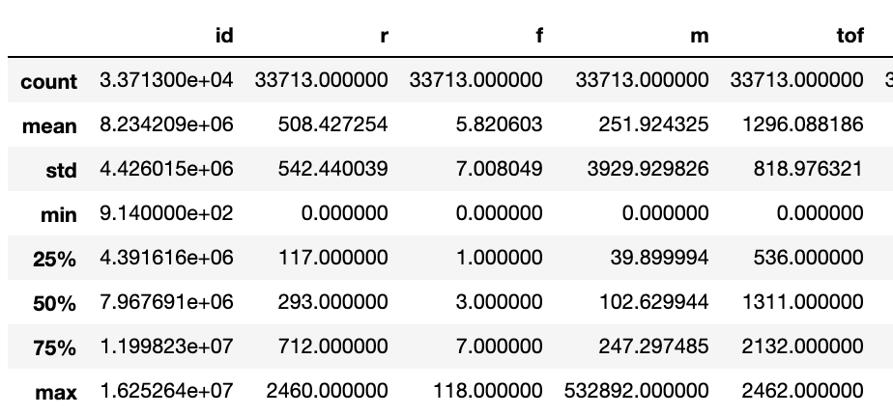
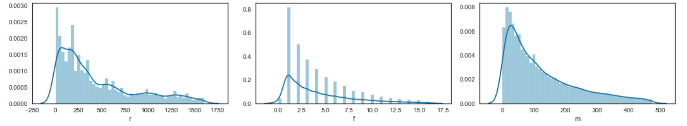
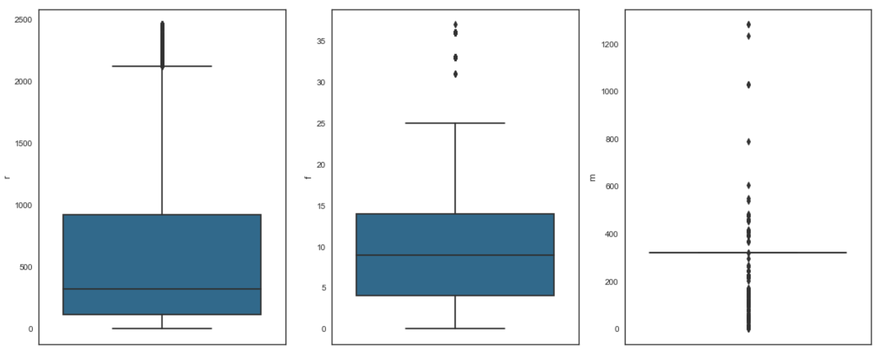
Data Analysis- process
Step 3 Data visualization
Specifically for the variable ‘tof’ - see next page
Step 1 Data preview
Process
Step 2 Remove outliers
Notes:
Recency; frequency; monetary -> 8 segments
N how many people to the segment
TOF - The number of days since the customer became registered.

Slide 15
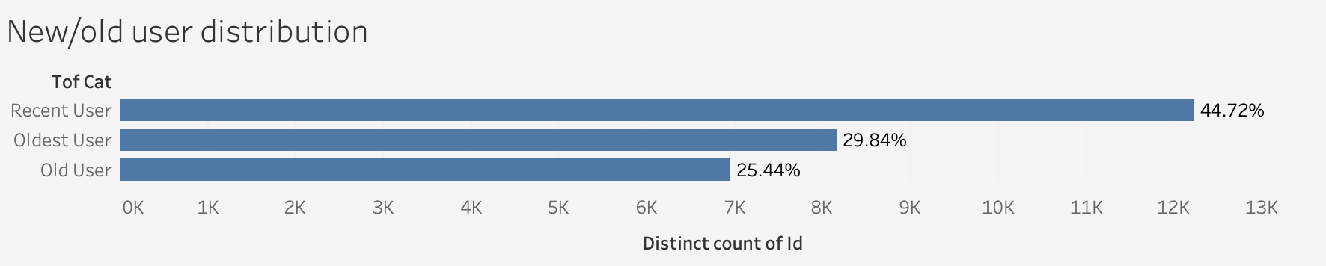
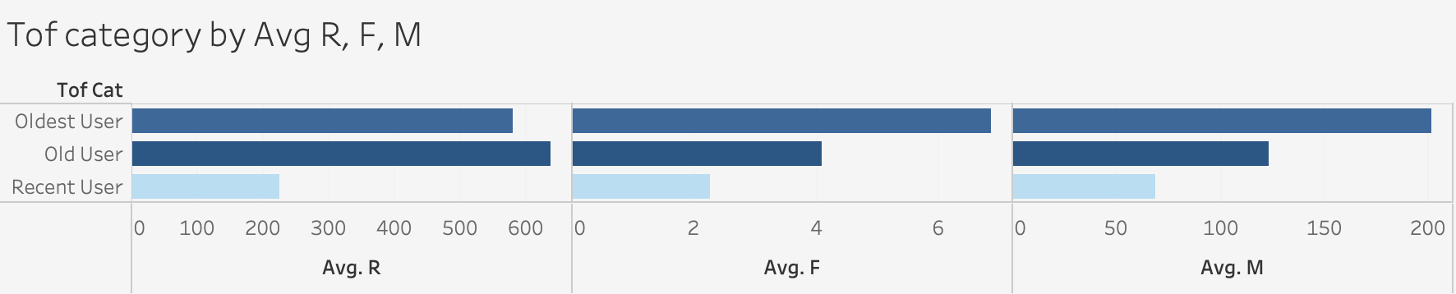
Data Analysis - tof
Notes:
Recency; frequency; monetary -> 8 segments
N how many people to the segment
From tof the decvribe of the user is like this. So the most recent user will be the analytics we need to use

Slide 16
Model Evaluation

Slide 17
RFM Score
All CONSUMERS
HIGH RECENCY: 2
LOW RECENCY: 1
HIGH FREQUENCY: 1
LOW FREQUENCY: 2
HIGH MONETARY: 1
LOW MONETARY: 2
111: Champions (N=5794)
112: Loyal (N=714)
121: Potential Loyalist(N=1349)
122: New Customers(N=5854)
211: Promising (N=4790)
212: Needs Attention(N=657)
221: About to Sleep (N=1748)
222: Hibernating (N=6457)
Notes:
Recency; frequency; monetary -> 8 segments
N how many people to the segment
Each variable two segment have 8segment N is the number

Slide 18
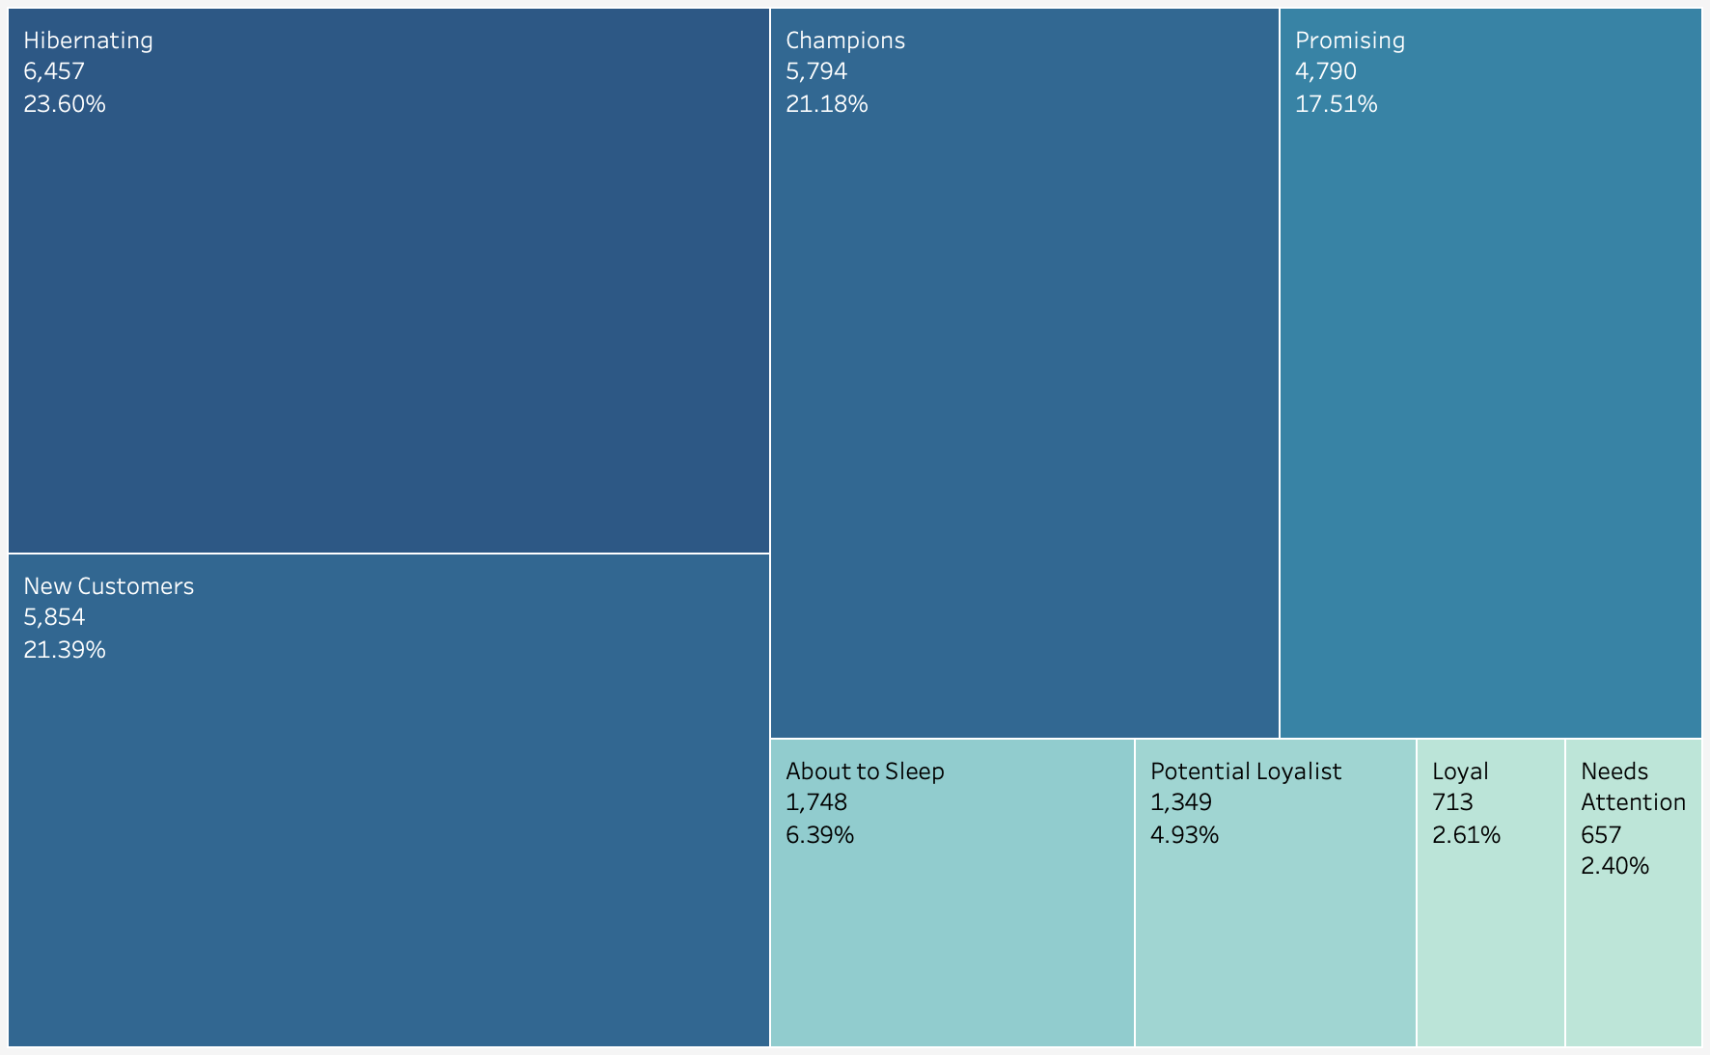
RFM Score
Cons:
Too many segments
Hard to define these 8 clusters
Notes:
Too many segments and it could be difficult for our action plan
It is hard to define these 8 clusters since we don’t know the weigh for r, f, m
Maybe one of you value recency or pay more attention
The performance for middle range segments are unknown

Slide 19
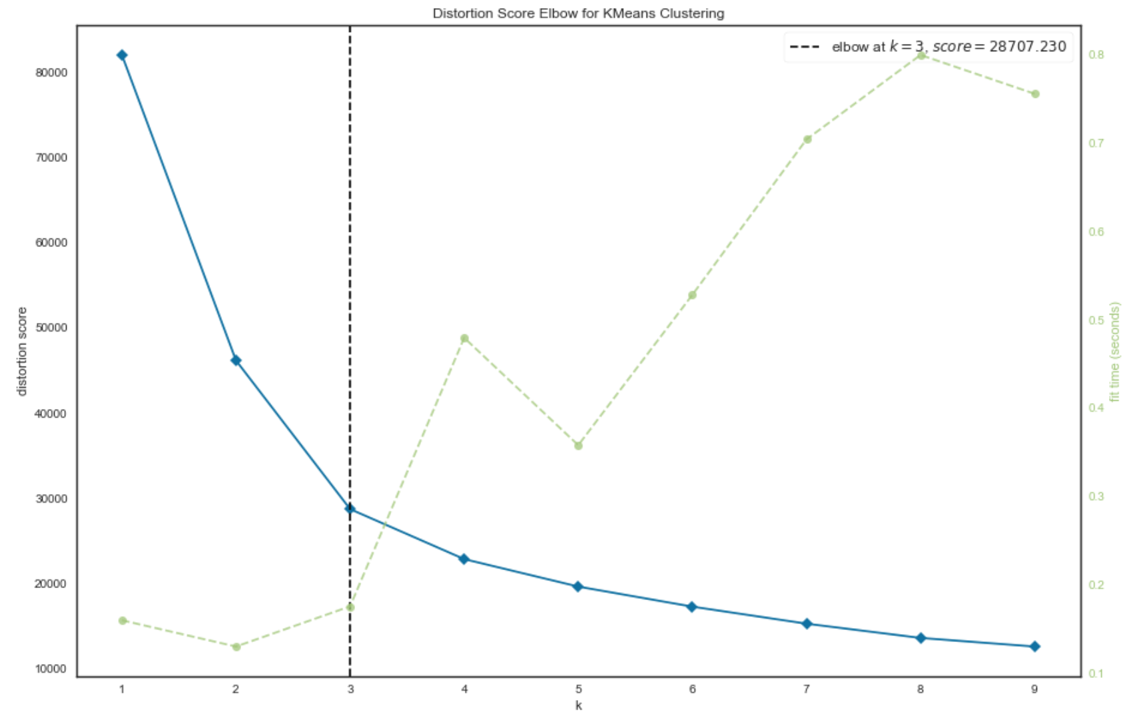
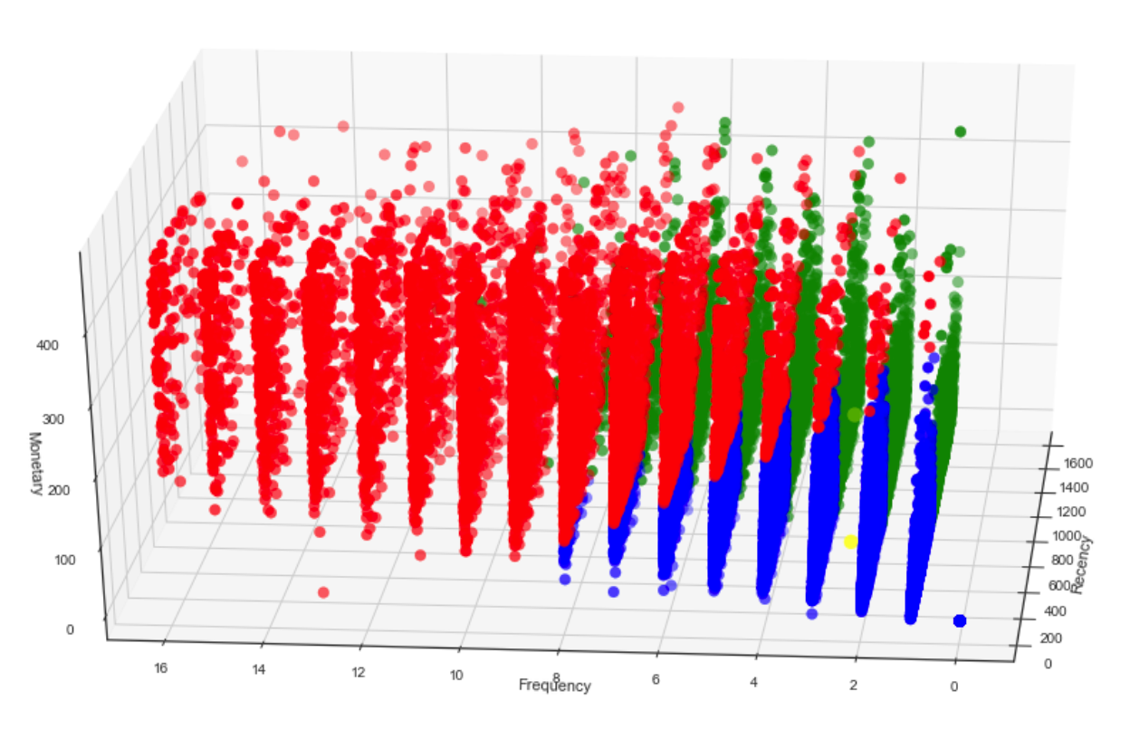
K-Means
Step1: Normalize data
Step2: Choose optimal K with Elbow method (k=3)
Step3: Label each record
Notes:
Let me introduce kmeans algorithm, elbow score curve and visualization on the right side

Slide 20
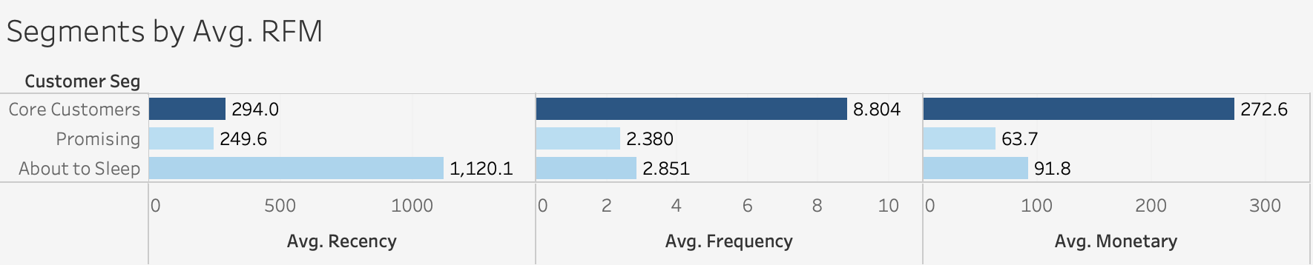
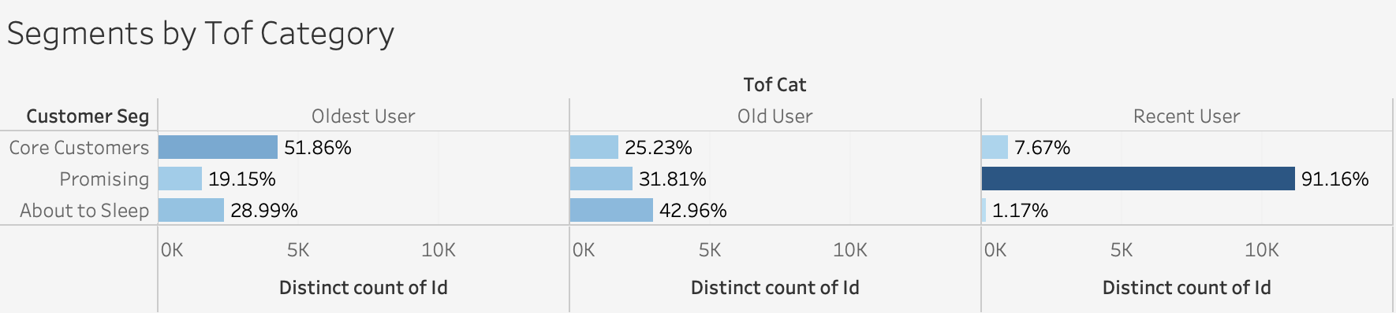
Segments at-a-glance
Notes:
Next, let’s take a glance at segments after K-Means model; we could tell average recency, frequency, monetary and tof differed by each

Slide 21
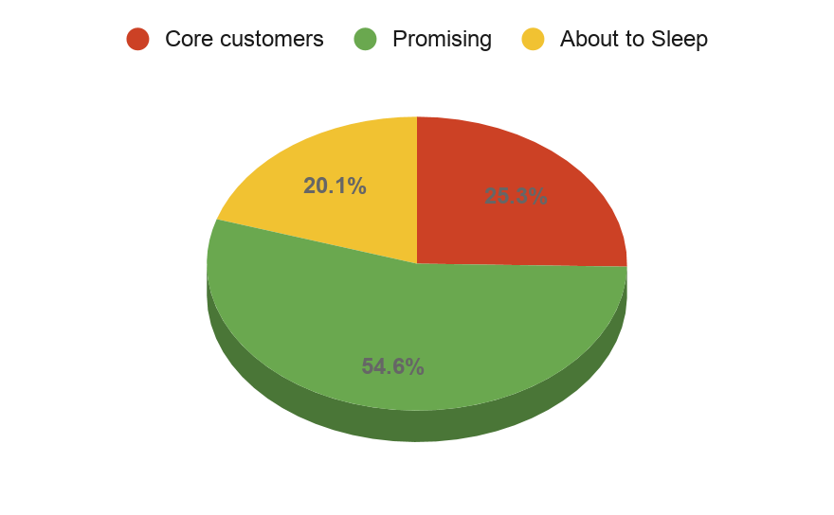
Segments At-a-glance
Sample Size 5,500
Avg. recency 1120.1
Avg. frequency 2.851
Avg. monetary 91.8
Pct. of oldest users 28.99%
Pct. of old users 42.96%
Pct. of recent users 1.17%
Sample Size 6,930
Avg. recency 294
Avg. frequency 8.804
Avg. monetary 272.6
Pct. of oldest users 51.86%
Pct. of old users 25.23%
Pct. of recent users 7.67%
Sample Size 14,932
Avg. recency 249.6
Avg. frequency 2.380
Avg. monetary 63.7
Pct. of oldest users 19.15%
Pct. of old users 31.81%
Pct. of recent users 91.16%
Notes:
We could have a clearer look of these statistics on this pie chart；red represents our core customers; green; yellow

Slide 22
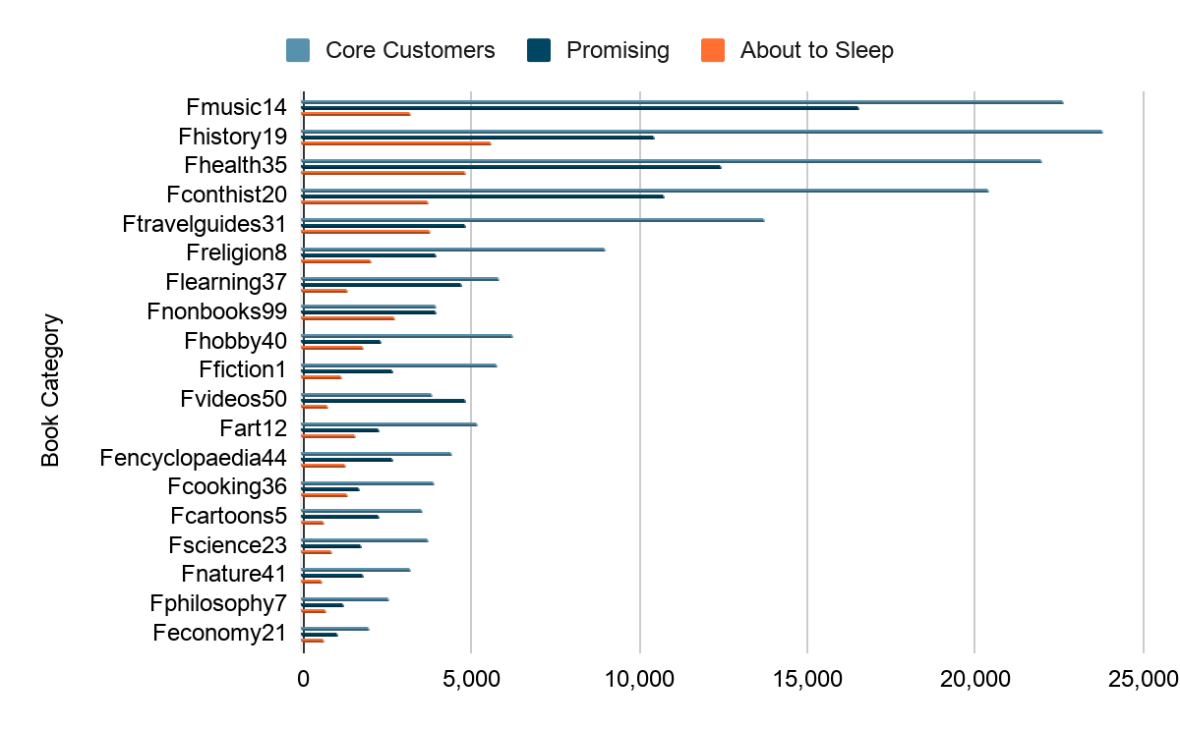
Frequency VS Book category
Notes:
Based on the segments, we look into the relation within the sum of frequency, book category and segments

Slide 23
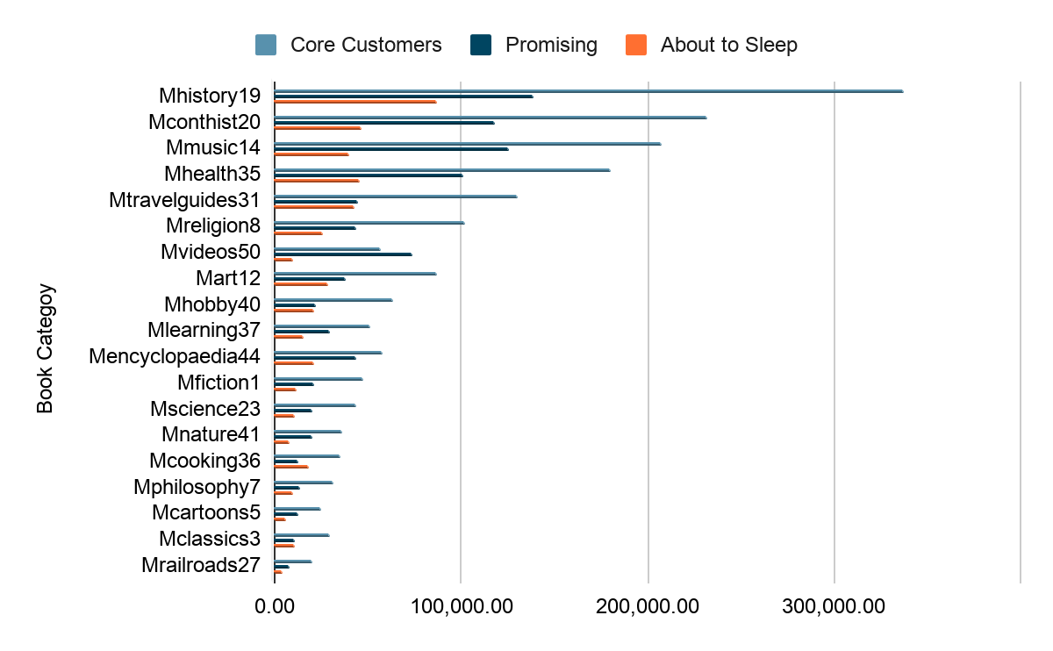
Monetary VS Book category
Notes:
As well as the sum of monetary; obviously, our core customers averagely have higher frequency and monetary than promising customer, than about to sleep for almost every category . history, music and health are most popular book category

Slide 24
Insights
Notes:
I’ll hand over to my teammate macy for

Slide 25
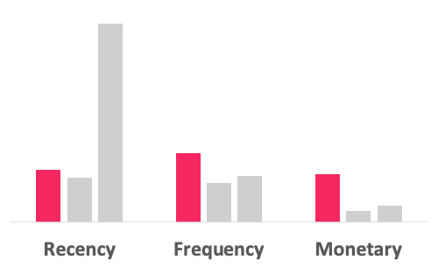
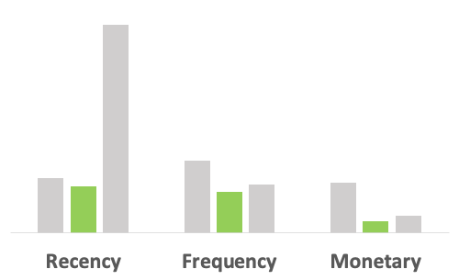
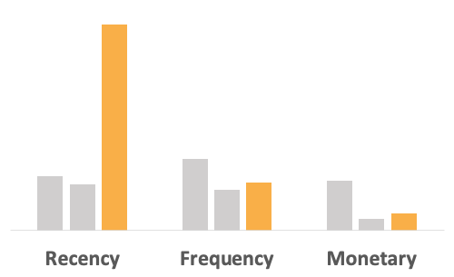
Action Plan
Core Customers
Promising
About to Sleep
Feature
Loyal (largest portion of oldest users)
Active (High frequency & monetary, low recency)
Strategy
Cannot lose
Action
Recommend popular items
Feature
New (largest portion of new users)
Not very active (low frequency & monetary, low recency)
Strategy
Gain interest
Action
Promotion on preference
Feature
Mainly old users (Almost no recent users)
Inactive (Low frequency & monetary, high recency)
Strategy
Win back
Action
Promotion on membership
Personalized Email recommendation

Slide 26
Advantages of New AI Solution
1.
More Personalized & Flexible
2.
Intelligent & Self-service Tool
3.
More competitive
4.
Economic Benefit
Notes:
More Personalized & Flexible
Recommend not only based on popularity, but customer also user preference (searching records…)
Intelligent & Self-service Tool
New user will be automatically assigned to appropriate segment, no manual work is required
More competitive
More competitive according to other competitors recommendation algorithm
Economic Benefit
Predicted to increase sales volume by 20% in one quarter based on testing results

Slide 27
Thanks for listening!

